Slide 1
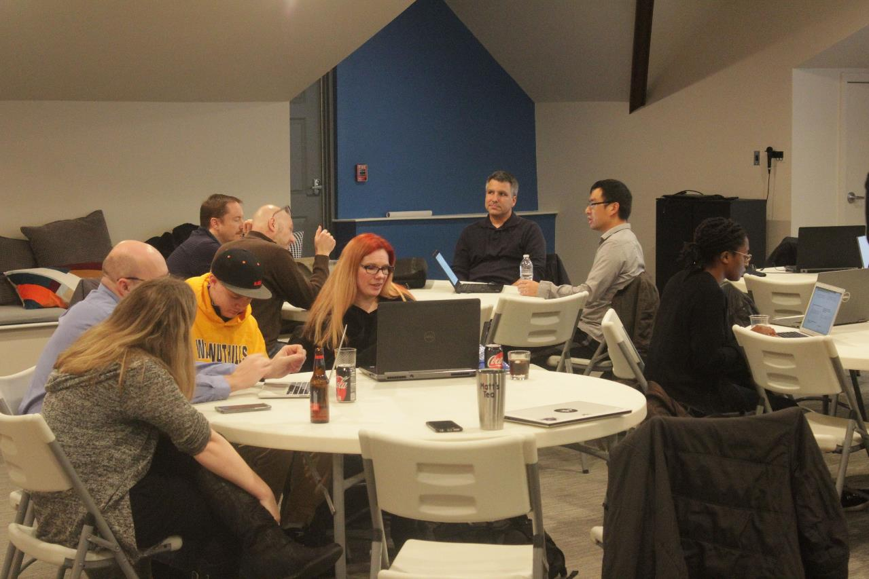
Code, Craft, Community
3/20/2024

Slide 2


Slide 3

Photo by Loren Biser on Unsplash

Slide 4
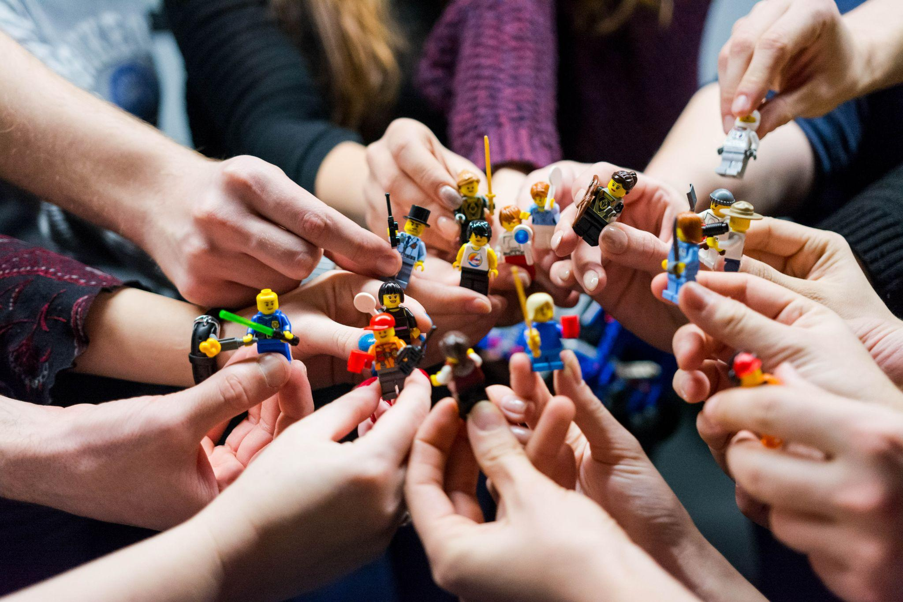
Photo by Vlad Hilitanu on Unsplash

Slide 5


Slide 6


Photo by Mimi Thian on Unsplash

Slide 7

Photo by Walkator on Unsplash

Slide 8

Photo by Alan Hardman on Unsplash

Slide 9

Photo by Julia Morales on Unsplash

Slide 10
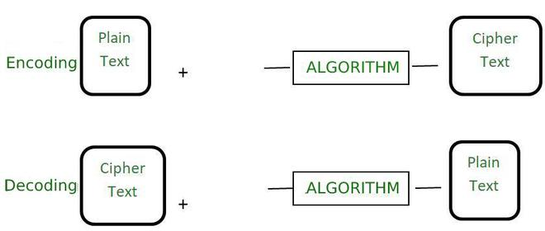
Encoding
The process of transforming data into such a format that it can be by a different type of system using publicly available algorithms.
Credit: https://www.geeksforgeeks.org/difference-between-encryption-and-encoding/

Slide 11
Encoding Examples
Base64 – used for safely transmitting binary data in a text-based protocol, e.g. email attachments
URL Encoding – used to safely include reserved characters and other arbitrary data in a URI
ASCII – used to store letters and numbers in a format the computer can recognize (also Unicode, UTF-8, UTF-16, etc)
Others?

Slide 12
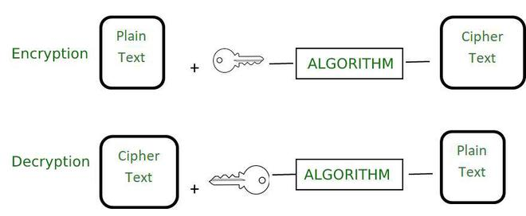
Encryption
The process to encode data securely such that only the authorized user who knows the key or password is able to retrieve the original data for everyone else it is just garbage.
Credit: https://www.geeksforgeeks.org/difference-between-encryption-and-encoding/

Slide 13
Encryption Examples
AES – Advanced Encryption Standard (Symmetric key)
RSA – Rivest Shamir Adelman (Asymmetric key)
Others?

Slide 14
Comparison
 | Encryption | Encoding
Definition | It is the process to encode data securely such that only the authorized user who knows the key or password is able to retrieve the original data for everyone else it is just garbage. | It is the process of transforming data into such a format that it can be used by a different type of system using publicly available algorithms.
Purpose | The purpose of encryption is to transform data to keep it secret from others. | The main purpose is the protection of the integrity of data.
Used for | It is used to maintain data confidentiality. | It is used to maintain data usability.
Reverse Process | The original data can be retrieved using decryption. | The original data can be retrieved using decoding. The algorithm used to encode the data is publicly available.
Key requirement | The encryption key is required to decrypt the data and get the original data. | The encryption key is not required to decrypt the data and get the original data.
Secure | The encrypted data is more secure. | The encoded data is less secure. It can easily be decoded.
Example of Algorithm | AES, RSA, and Blowfish. | ASCII, UNICODE, URL encoding, Base64.
Real-life example | Securely sending a password over the internet. | viewing special characters on the web page.
Credit: https://www.geeksforgeeks.org/difference-between-encryption-and-encoding/

Slide 15
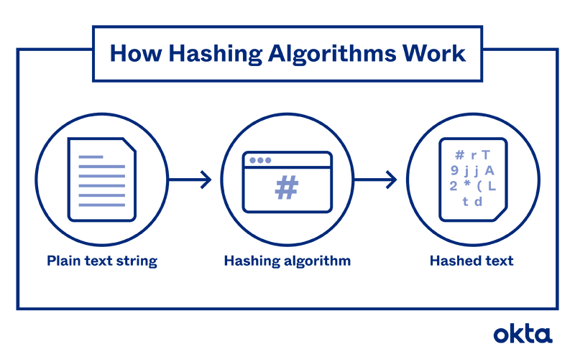
Hashing
The process of transforming any given key or a string of characters into another value.
Credit: https://www.techtarget.com/searchdatamanagement/definition/hashing and https://www.okta.com/identity-101/hashing-algorithms/

Slide 16
Hashing Examples
MD5 – Message Digest 5
SHA – Secure Hash Algorithm
Others?

Slide 17
Tonight’s Challenge
See the repository!

Slide 18
Wifi Password: ComeJoinUs2!
https://github.com/Ingage-Meetup/20240320-encryption

Slide 19

Discord Server
https://discord.gg/bqPVXD4d

Slide 20

Handy QR Codes

Slide 21
Raffle
A Jetbrains license, good for any of their IDEs (IntelliJ, WebStorm, etc.) for one year. It is a “perpetual fallback license”, meaning you can continue to use the version of the IDE that was activated, even after the year has passed and the license is expired.
Winners, talk to Jim Kriz, who will send you a PDF with details to redeem your license.
Notes:
Suppose you're on a game show, and you're given the choice of three doors: Behind one door is a car; behind the others, goats. You pick a door, say No. 1, and the host, who knows what's behind the doors, opens another door, say No. 3, which has a goat. He then says to you, "Do you want to pick door No. 2?" Is it to your advantage to switch your choice?

Slide 22
As developers we are:
…deliberately trying to get better
…not focused on any particular stack, vendor, or language
…better as a group
…here to write code, think about code, discuss the craft
…dreaming of eating pizza together

